Slide 1



Welcome
Welcome
Welcome
Welcome
Welcome
Welcome
Welcome
Welcome
Welcome
Welcome
Welcome
Welcome
Welcome
Welcome
Welcome
Welcome
Welcome
Welcome
START NOW
Welcome
Welcome
Welcome
Welcome
Welcome
Welcome
Welcome
Welcome
Welcome
Welcome
Welcome
Welcome
Welcome
Welcome
Welcome
Welcome
Welcome
Welcome

Slide 2
Climate Change Data Analysis: Evidence-Based Policy Recommendations

Slide 3


THE PROBLEM
There is an urgent need for evidence-based policies to reduce emissions, protect ecosystems, and increase global resilience.
Accelerating climate change is causing rising temperatures, extreme weather, and environmental degradation affecting billions of people.
Analyzing interactions between emissions, energy use, and natural resources across countries can highlight policy opportunities, such as promoting renewables and forest conservation, to build a more resilient world.

Slide 4
T
W
Dataset Overview & Geographic Coverage
Data Period:
2000-2023 (24 years)
Total Observations:
1000 Rows
Data Quality:
Complete Dataset, no missing values after cleaning
S
Top Country Representation:
O

Slide 5
Dataset Overview & Geographic Coverage
Indonesia:
75 Observations
USA:
73 Observations
South Africa:
73 Observations
India:
70 Observations

Slide 6
Dataset Overview & Geographic Coverage
75 Observations
73 Observations
73 Observations
70 Observations
S
Indonesia:
75 Observations
USA:
73 Observations
South Africa:
73 Observations
India:
70 Observations

Slide 7
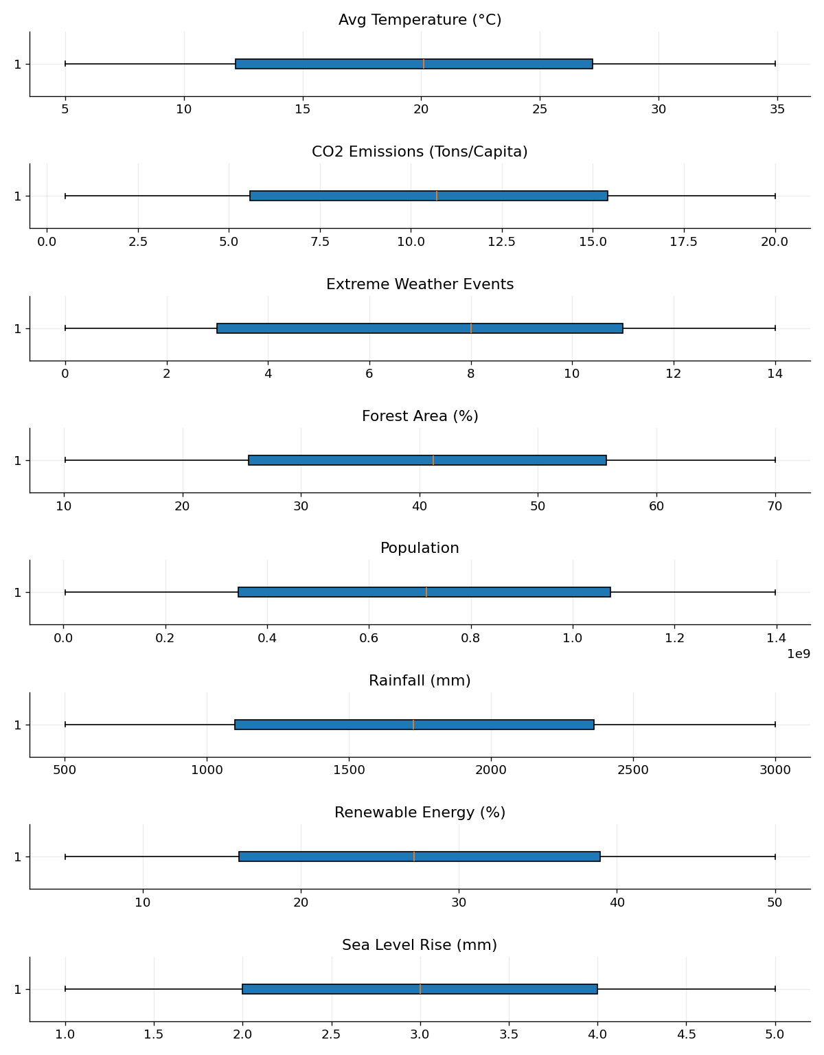
Data Quality & Preprocessing
#01
#03
Data Cleaning Process
Winsorization applied to handle outliners
#04
#02
No outliners Detected
Population Data Cleaned

Slide 8
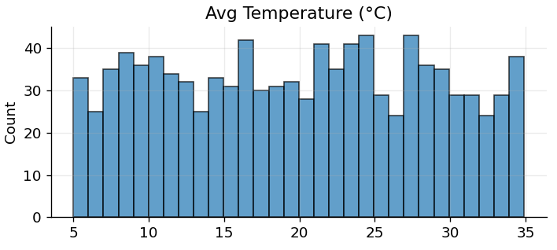
How are global temperatures distributed?
Temperature Range:
5.0°C to 34.9°C
01
Click on the graph to enlarge it
Mean:
19.9°C (std: 8.5°C)
Key Finding:
Countries above 27.2°C (75th percentile) at extreme heat risk

Slide 9
Where are the biggest renewable energy adoption gaps?
Policy Implication:
Focus renewable incentives and technology transfer on laggard countries
Mean:
27.3% (std: 13.0%)
02
Adoption Range:
5.1% to 50.0%
Critical Gap:
Bottom quartile countries below 16.1% adoption

Slide 10
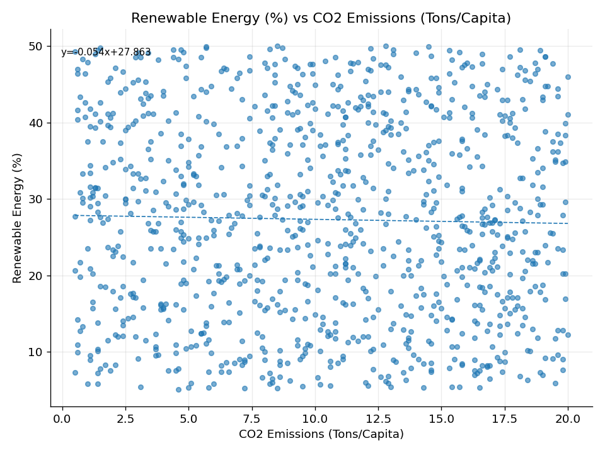
Relationship between CO2 emissions and renewable adoption?
04
Click on the graph to enlarge it
Critical Insight: Renewable adoption alone insufficient for emission reduction
Policy Implication:
Need comprehensive decarbonization strategies beyond just renewables
Key Finding:
Very weak correlation detected

Slide 11
What are the key climate variable relationships?
Temperature vs Sea Level:
0.059 (global warming signal)
CO2 vs Year:
0.041 (insufficient emission progress)
05
Year vs Population:
0.072 (population growth over time)
Renewable vs Temperature:
0.065 (hot countries adopting solar)

Slide 12
Policy Implication:
Current policies need acceleration - insufficient progress
CO2 emissions trends 2000-2023
06
Finding:
CO2 shows slight positive correlation with year (0.041)
Critical Gap:
No significant per-capita emission reduction over 23 years

Slide 13
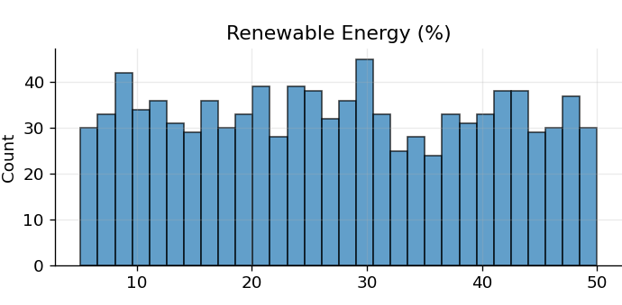
Click on the graph to enlarge it
Renewable energy growth trends
07
Identify successful policy periods to replicate globally

Slide 14
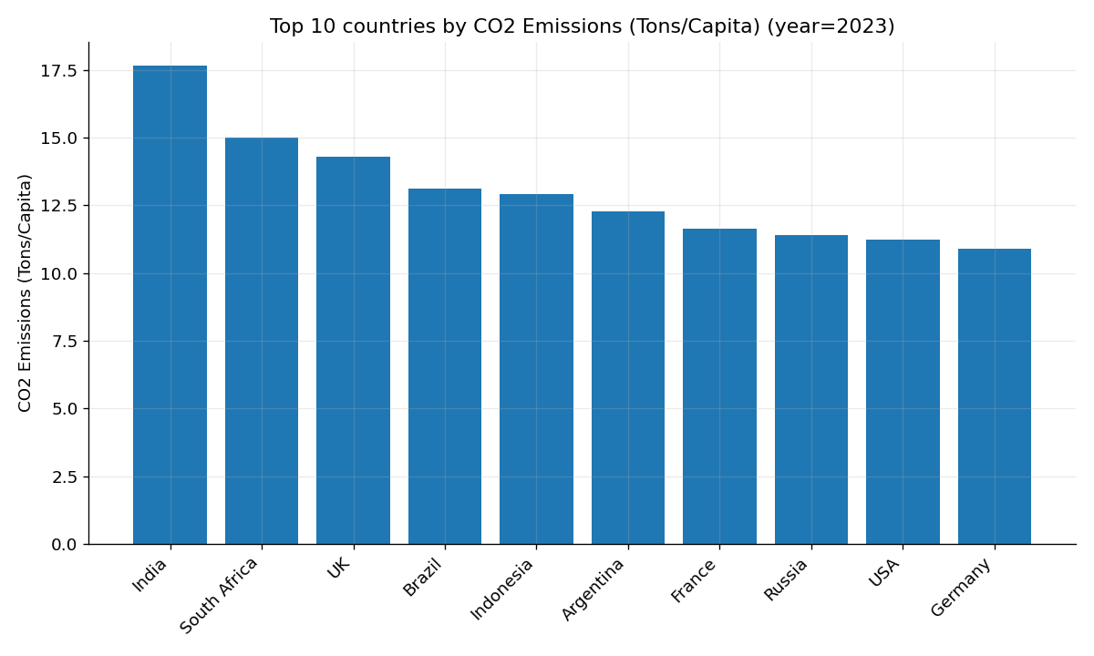
Which countries need priority attention?
Click on the graph to enlarge it
USA
(73 observations)
Indonesia
(75 observations)
08
Russia
(74 observations)
India
(70 observations)
South Africa
(73 observations)

Slide 15
Distinct country clusters identified
Profile1:
High population, newer data, higher renewables
Strategy:
Tailor policies by profile type rather than universal approach
Profile 2:
Temperature-sensitive with sea level concerns
Profile 3:
Established economies with stable emission patterns

Slide 16
Coastal Protection:
Regardless of local temperature
Renewable Acceleration:
Technology transfer to <16.1% adoption countries
Comprehensive Decarbonization:
Beyond renewables alone
Target Adaptation:
Focus funds on countries >27.2°C
Immediate Policy Recommendations
Universal Disaster Prep:
Across all temperature zones

Slide 17
Strategic Policy Framework
Differentiated Policy Frameworks:
Climate profile-specific strategies
Regional Cooperation:
Group by similar climate profiles
Enhanced Diplomatic Pressure:
Focus on top emitters
Policy Acceleration:
Current emission reduction insufficient
Integrated Climate Policies:
Address multiple variables simultaneously

Slide 18
Next Steps & Data Enhancement
Interactive dashboards for country-specific profiles

Slide 19
Pre/post Paris Agreement (2015) temporal analysis
Economic variables integration (GDP, trade data)

Slide 20
Sectoral emission breakdowns
Predictive modeling for policy scenarios

Slide 21


03
02
01
" Policy Success! "
"Key Takeaway! "
" Critical Insight! "
3
Renewable energy adoption is important but insufficient alone.
Countries need comprehensive decarbonization strategies addressing multiple climate variables simultaneously.
Climate change is a complex, interconnected challenge requiring tailored, integrated policy responses rather than universal solutions
CONCLUSION
Requires evidence-based approaches tailored to specific climate profiles and development stages.
2
1

Slide 22
03
02
01
" Policy Success! "
"Key Takeaway! "
" Critical Insight! "
3
Renewable energy adoption is important but insufficient alone.
Countries need comprehensive decarbonization strategies addressing multiple climate variables simultaneously.
Climate change is a complex, interconnected challenge requiring tailored, integrated policy responses rather than universal solutions
Requires evidence-based approaches tailored to specific climate profiles and development stages.
CONCLUSION
2
1

Slide 23
03
02
01
" Policy Success! "
"Key Takeaway! "
" Critical Insight! "
3
Renewable energy adoption is important but insufficient alone.
Countries need comprehensive decarbonization strategies addressing multiple climate variables simultaneously.
Climate change is a complex, interconnected challenge requiring tailored, integrated policy responses rather than universal solutions
Requires evidence-based approaches tailored to specific climate profiles and development stages.
CONCLUSION
2
1

Slide 24
03
02
01
" Policy Success! "
"Key Takeaway! "
" Critical Insight! "
3
Renewable energy adoption is important but insufficient alone.
Countries need comprehensive decarbonization strategies addressing multiple climate variables simultaneously.
Climate change is a complex, interconnected challenge requiring tailored, integrated policy responses rather than universal solutions
Requires evidence-based approaches tailored to specific climate profiles and development stages.
CONCLUSION
2
1

